Slide 1
Chapter 11 Polymorphism
Sections 11.7-11.10

Slide 2
Objectives
    To discover polymorphism and dynamic binding (§§11.7–11.8).
    To describe casting and explain why explicit downcasting is necessary (§11.9).
    To explore the equals method in the Object class (§11.10).

Slide 3

Superclasses and Subclasses
GeometricObject
CircleFromSimpleGeometricObject
RectangleFromSimpleGeometricObject
TestCircleRectangle
Run

Slide 4
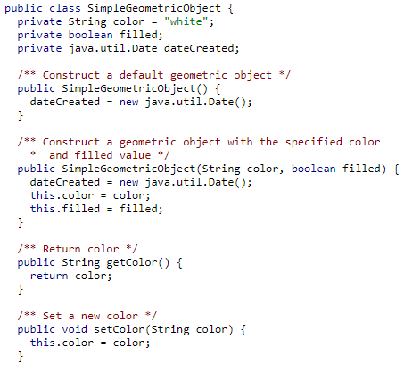
SimpleGeometricObject Class

Slide 5
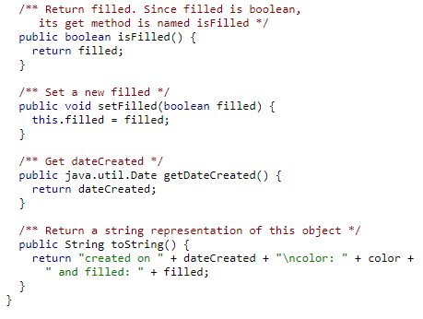
GeometricObject Class

Slide 6
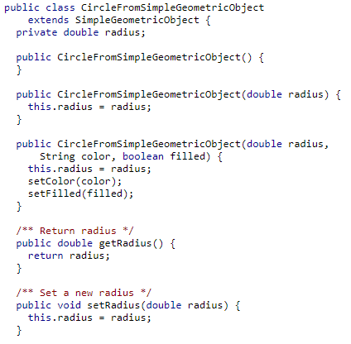
CircleFromSimpleGeometricObject Class

Slide 7
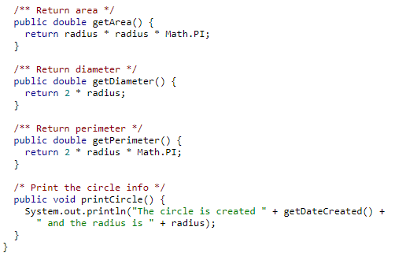
CircleFromSimpleGeometricObject Class

Slide 8
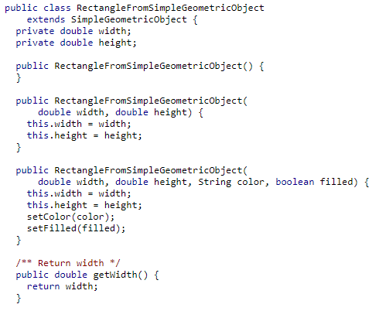
RectangleFromSimpleGeometricObject Class

Slide 9
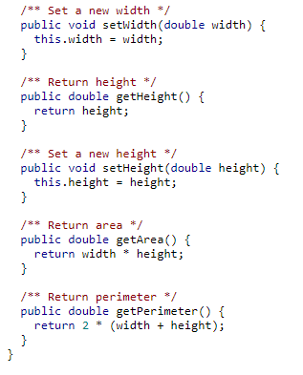
RectangleFromSimpleGeometricObject Class

Slide 10
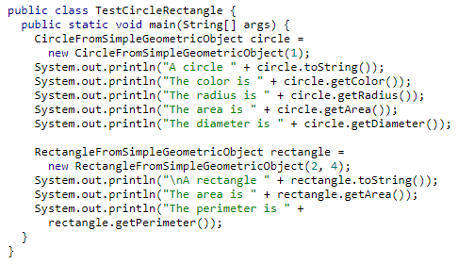
Class with Main Method

Slide 11
Exercise
Continuing with the previous exercise, in the Test class, let’s write a method displayObject that takes a Circle object as a parameter and displays the object’s dateCreated and color value.
public static void displayObject(CircleFromSimpleGeometricObject object)
{
System.out.println("Created on " + object.getDateCreated());
System.out.println("Color is " + object.getColor());
}

Slide 12
Exercise
Now, write a method displayObject that takes a Rectangle object as a parameter and displays the object’s dateCreated and color value.
public static void displayObject(RectangleFromSimpleGeometricObject object) {
System.out.println("Created on " + object.getDateCreated());
System.out.println("Color is " + object.getColor());
}

Slide 13
Exercise
public class TestApplication {
public static void main(String[] args) {
CircleFromSimpleGeometricObject c = new CircleFromSimpleGeometricObject(1, "red", false);
displayObject(c);
RectangleFromSimpleGeometricObject r = new RectangleFromSimpleGeometricObject(1, 1, "blue", true);
displayObject(r);
}

Slide 14
The two displayObject Methods
public static void displayObject(CircleFromSimpleGeometricObject object)
{
System.out.println("Created on " + object.getDateCreated());
System.out.println("Color is " + object.getColor());
}
public static void displayObject(RectangleFromSimpleGeometricObject object) {
System.out.println("Created on " + object.getDateCreated());
System.out.println("Color is " + object.getColor());
}

Slide 15
Polymorphism
Polymorphism means that a variable of a supertype can refer to a subtype object.
  A subclass is a specialization of its superclass; every instance of a subclass is also an instance of its superclass, but not vice versa.
  For example, every circle is a geometric object, but not every geometric object is a circle.
  Therefore, you can always pass an instance of a subclass to a parameter of its superclass type.

Slide 16
Polymorphism Example
public static void displayObject(SimpleGeometricObject object) {
System.out.println("Created on " + object.getDateCreated() + ". Color is " + object.getColor());
}
}
public class TestApplication {
public static void main(String[] args) {
CircleFromSimpleGeometricObject c = new CircleFromSimpleGeometricObject(1, "red", false);
displayObject(c);
RectangleFromSimpleGeometricObject r = new RectangleFromSimpleGeometricObject(1, 1, "blue", true);
displayObject(r);
}
You can invoke displayObject above by passing any instance of GeometricObject (Circle or Rectangle). An object of a subclass can be used wherever its superclass object is used. This is commonly known as polymorphism. Polymorphism allows methods to be used generically for a wide range of object arguments. This is known as generic programming.

Slide 17
Polymorphism, Dynamic Binding and Generic Programming
public class TestClass {
public static void main(String[] args){
m(new GraduateStudent());
}
public static void m(Student s)
{
System.out.println(s.printMessage());
}
}
class GraduateStudent extends Student
{
@Override
public String printMessage()
{
return("GraduateStudent");
}
}
class Student
{
public String printMessage()
{
return("Student");
}
}
In the method m’s parameter:
Student s = new GraduateStudent();
Here, s’s declared type is Student but the actual type is GraduateStudent.
The declared type of the reference variable decides which method to match at compile time.
Which printMessage() method is invoked is determined by s’s actual type at runtime. This is known as dynamic binding.

Slide 18
Casting Objects
Casting can be used to convert an object of one class type to another within an inheritance hierarchy.
Let’s say that the Person class has two subclasses – Student and Faculty
The following statement is valid because an instance of Student is an instance of Person:
Person p = new Student();
However, the following will give a compile time error:
Student s = p;
The above gives a compile time error because a Person is not necessarily an instance of Student.
Even though you can see that p is really a Student object, the compiler is not so clever to know it.
To tell the compiler that p is a Student object, use an explicit casting as follows: Student s = (Student) p; // Explicit casting

Slide 19
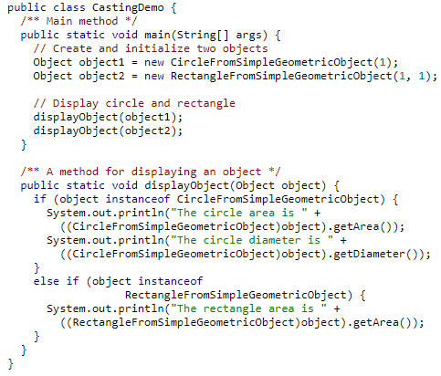
The instanceof Operator
The instanceof operator is used to test whether the object is an instance of the specified type.
CastingDemo
Run

Slide 20
The equals Method
Like the toString() method, the equals(Object) method is another useful method defined in the Object class.
The equals() method compares the contents of two objects.
The syntax for invoking it is:
object1.equals(object2);
The default implementation of the equals method in the Object class is:
public boolean equals(Object obj) {
return this == obj;
}

Slide 21
The equals Method
This default implementation checks whether two reference variables point to the same object using the == operator.
The == operator is stronger than the equals method, in that the == operator checks whether the two reference variables refer to the same object.
You should override the default equals method in your custom class to test whether two distinct objects have the same content.
The equals method is overridden in many classes in the Java API, such as java.lang.String and java.util.Date, to compare whether the contents of two objects are equal.

Slide 22
The equals Method
You can override the equals method in the Circle class to compare whether two circles are equal based on their radius as follows:
@Override
public boolean equals(Object o) {
if (o instanceof Circle) {
return radius == ((Circle)o).radius;
}
else
return false;
}

